Slide 1

Inertial Microfluidics
ME 619 Fundamentals of Microfluidics
From Fundamental Theories to Biomedical Application
Presented by
Neeraj Kumar (244103315)
Anurag Anand (244103327)
Under the guidance of
Prof. Amaresh Dalal
Department of Mechanical Engineering
IIT Guwahati

Slide 2
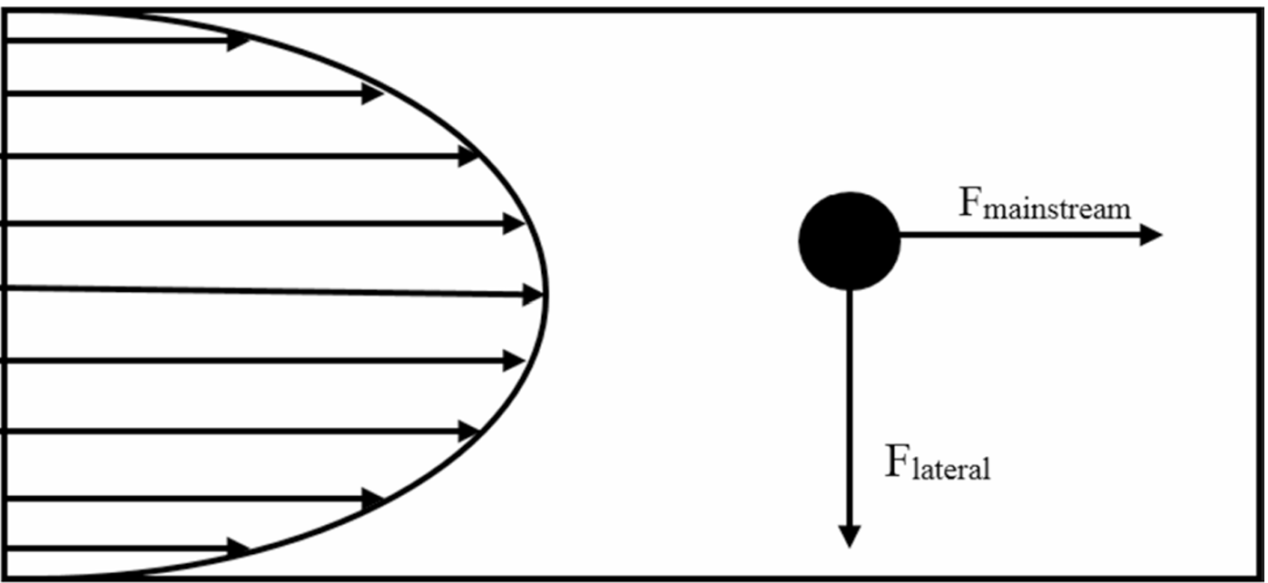
Introduction
Inertial microfluidics works at moderate Reynolds numbers (1 < Re < 100).
Combines viscous and inertial forces for particle control.
Enables label-free, passive particle focusing and separation.
Useful in diagnostics, drug delivery, and material synthesis.
Drag and lift forces on particle in a fluid [1]
1

Slide 3
Objective
Study the balance of inertial and viscous forces in microflows.
Analyze particle behavior and equilibrium in microchannels.
Understand secondary flows like Dean flow in curved channels.
Explore biomedical uses: malaria, cancer, and bacterial cell separation.
2

Slide 4
Literature Review
Di Carlo [2] and Zhou and Papautsky [3] explained how shear-induced and wall-induced lift forces drive particles toward equilibrium positions in channels.
Mishra et al. [1] emphasized that inertial microfluidics enables label-free particle control by exploiting fluid inertia, removing the need for external fields.
Zhang et al. [4] and Park et al. [5] showed that Dean vortices in curved or spiral microchannels significantly enhance particle separation and mixing.
Farajpour [6] noted that focusing behavior is sensitive to parameters such as channel geometry, particle-to-channel size ratio, and flow velocity.
3

Slide 5
According to Zhang et al. [4] and Mishra et al. [1], numerical approaches like Lattice Boltzmann Method (LBM) and finite element analysis (FEA) optimize flow simulation and device design.
Park et al. [5] and Shi [7] reported successful biomedical applications, including CTC isolation, exosome enrichment, and blood component analysis.
Farajpour [6] and Shi [7] explored the use of inertial microfluidics in biofuel production (e.g., microalgae sorting) and environmental monitoring.
Despite its benefits, Mishra et al. [1] and Shi [7] discussed major challenges including clogging, biofouling, integration complexity, and high fabrication cost.
4

Slide 6
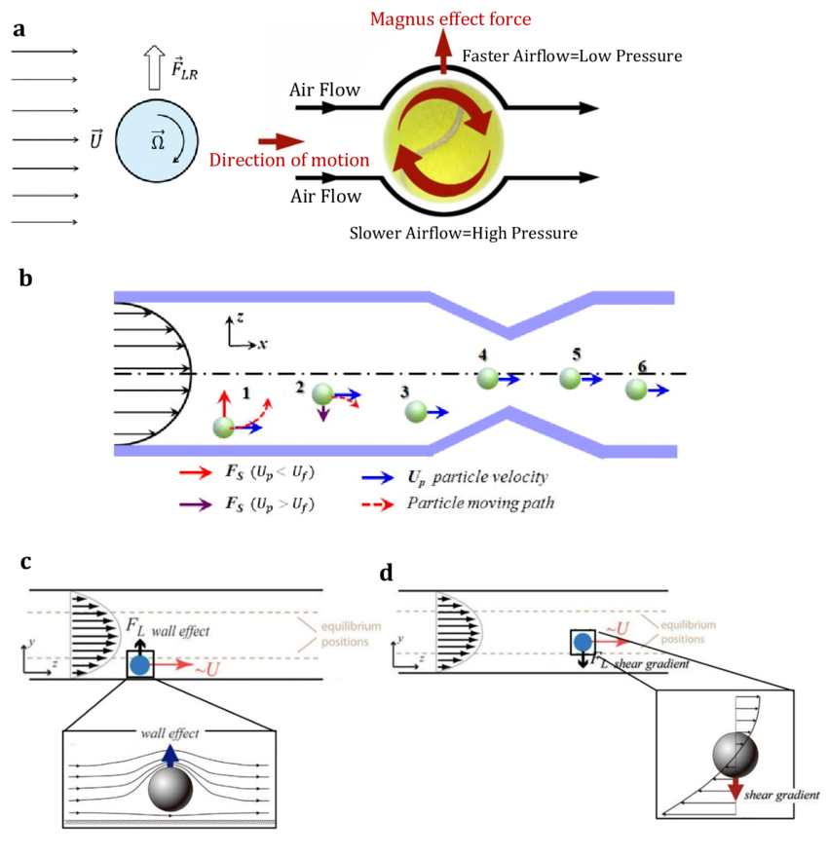
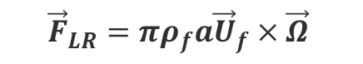



Fundamentals of Inertial Microfluidics
Viscous Drag Force: arises from fluid resistance on a particle.
Wall Shear Stress
Pressure Stresses
Magnus Force: a lift force generated by particle rotation in flow.
Saffman Force: induced by velocity slip in shear flow.
Net Inertial Lift Force: determines equilibrium positions.
$$F_{drag}=S×f_{drag}=\frac{πa^{2}f_{drag}}{4}$$
$${\vec{F}}_{LR}=πρ_{f}a{\vec{U}}_{f}×\vec{Ω}$$
$$F_{s}=\frac{KV_{t}a^{2}{(γv^{−1})}^{\frac{1}{2}}}{4}$$
$$F_{L}= \frac{f_{L}ρ_{f}{U_{f}}^{2}a^{4} }{H^{2}}$$
The four components of lift force
5

Slide 7
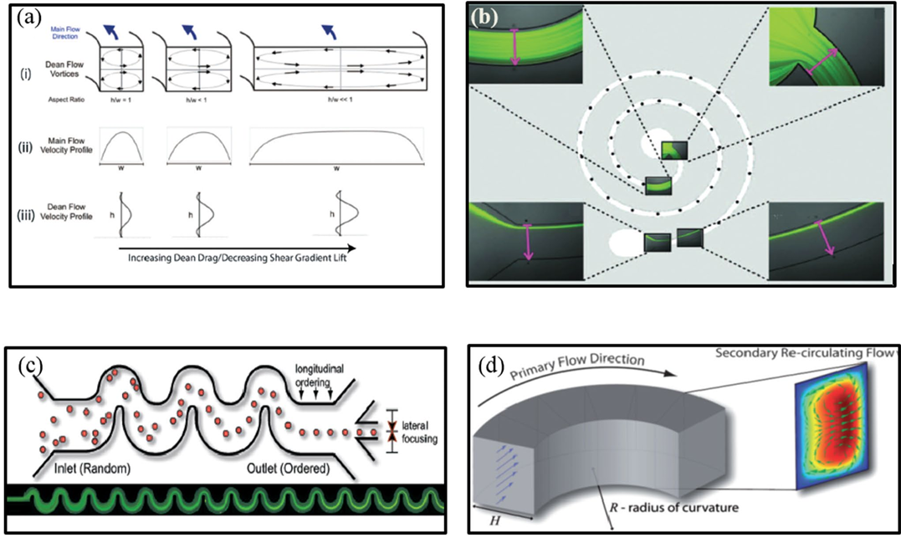
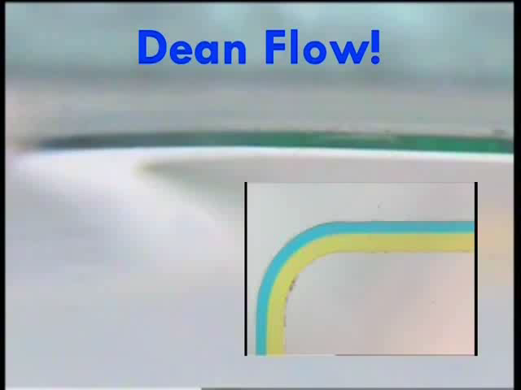

Dean Number (De): quantifies secondary flow strength in curved channels.
$$De=Re\sqrt{\frac{H}{2R} }$$
a. Dean flow induced due to velocity mismatch in a curving channel (Martel and Toner, 2012) b. Spiraling channels, reproduced with permission from Martel and Toner (2012), AIP Publishing c. Alternating asymmetric curving channels (Di Carlo et al., 2007; Di Carlo, 2009), Copyright National Academy of Sciences, U.S.A. d. Dean flow in a curved channel (Di Carlo, 2009).
Dean Flow
6

Slide 8
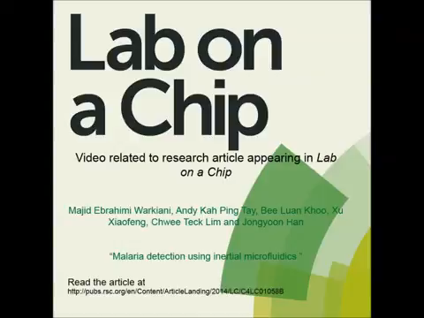
Experimental Methodology in biomedical application
Rapid Malarial Detection via Inertial Microfluidic Separation
Fast Detection: Inertial microfluidics enables rapid malaria diagnosis without labels.
High Purity: Two-stage separation improves parasite concentration.
No Chemicals Needed: Works without dyes or reagents.
Smart Design: Uses channel shape and flow to separate cells.
Field-Ready: Ideal for use in remote or low-resource areas.
Malaria detection using inertial microfluidics
7

Slide 9
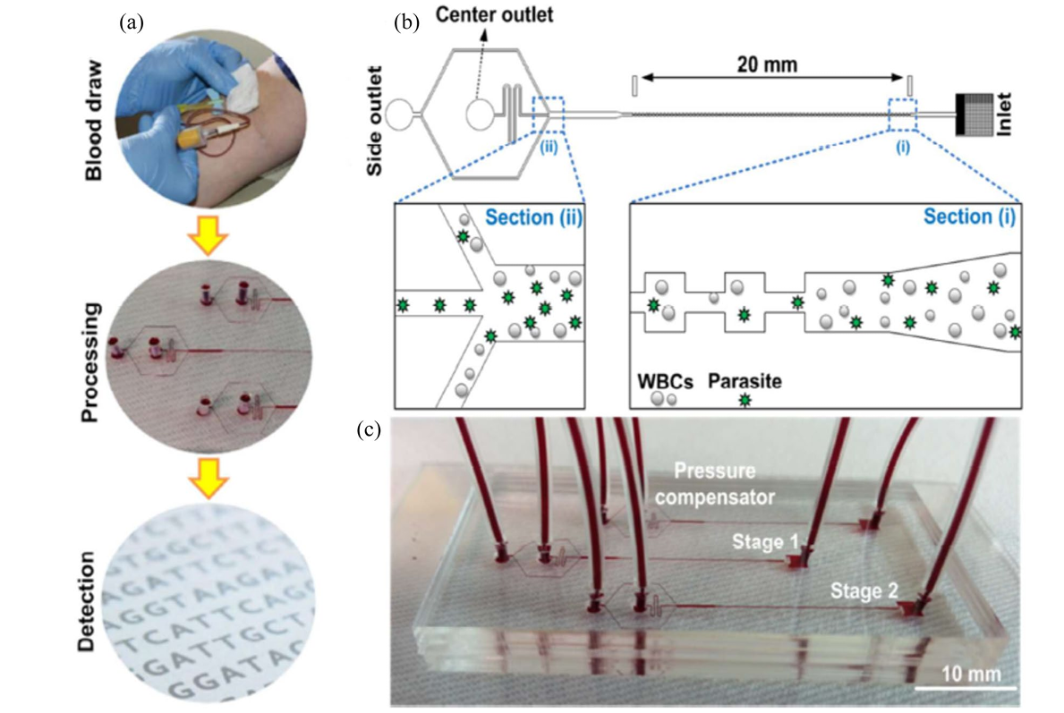
a. Overview of the sample processing steps. b. Diagram illustrating the configuration and functional operation of the microfluidic chip. c. Photographs showing the real-world implementation of the cascading device designed for enriching malarial parasites. This figure is reproduced with permission from the Royal Society of Chemistry, as originally published by Warkiani et al. (2015).
8

Slide 10
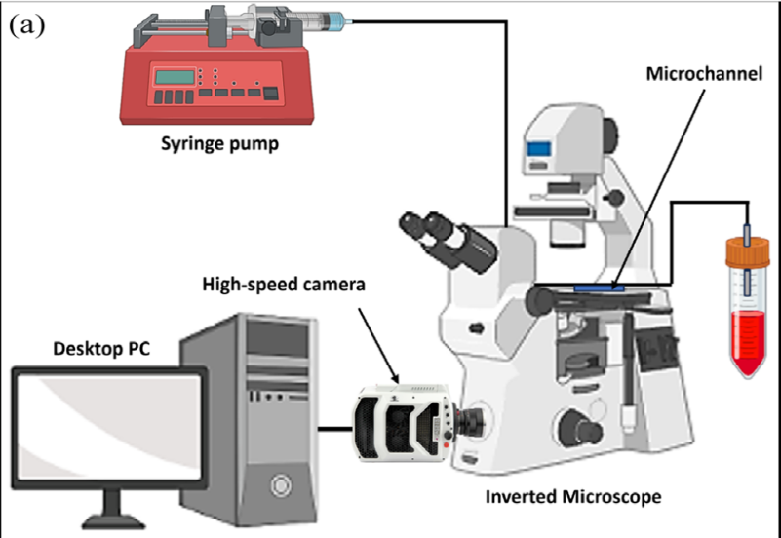
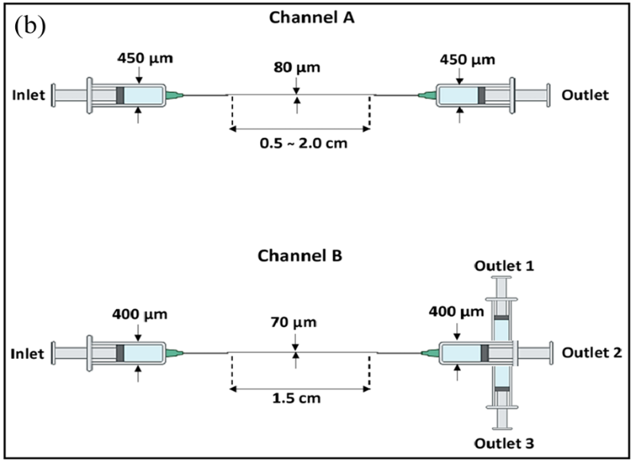
Isolation of Circulating Cancer Cells Using Inertial Microfluidics
Label-Free Separation: CTCs are isolated without chemical tags using flow dynamics.
Size-Based Sorting: Cancer cells are separated from blood cells due to size and stiffness differences.
High Throughput: Spiral and serpentine channels allow fast processing of large blood volumes.
Minimal Cell Damage: Gentle hydrodynamic forces preserve cell integrity.
Improves Diagnosis: Enables early cancer detection and monitoring through blood samples.
a. Showing the experimental setup, highlighting where the cancer cell migration occurs. b. Showing two different designs of PDMS microchannel systems used in the experiment. These designs are based on the work by Tanaka et al. (2012).
9

Slide 11
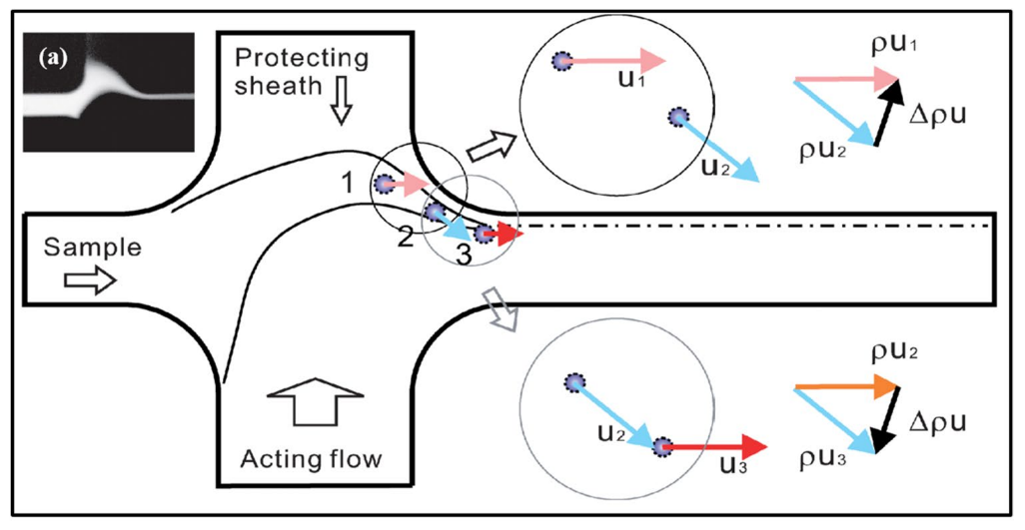
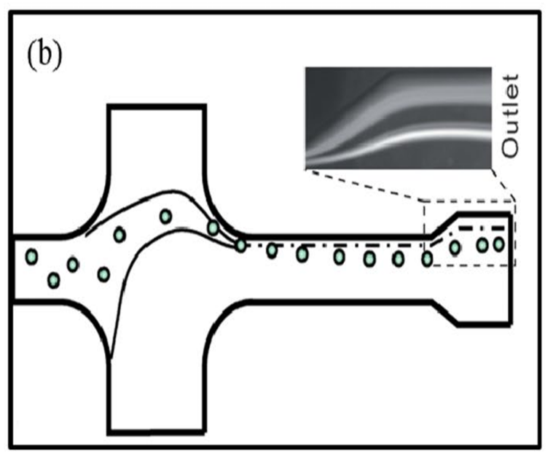
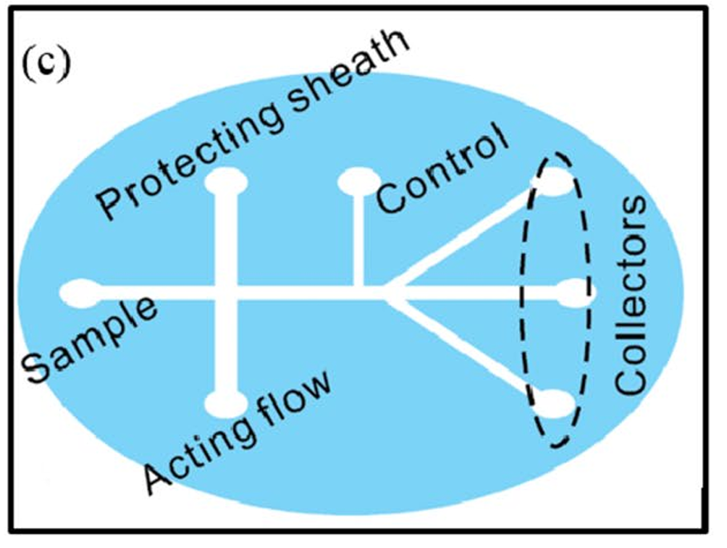
Soft Inertial Microfluidics for Bacteria Separation from Human Blood Cells
Size-Based Separation: Differentiates bacteria (1–2 µm) from larger blood cells (6–8 µm).
Label-Free & Gentle: No need for dyes or harsh treatments; preserves sample integrity.
Curved Channel Design: Enhances separation using focused flow and inertia.
High Sensitivity: Effective even at low bacterial concentrations.
Fast & Portable: Suitable for rapid infection diagnosis in clinical or field settings.
a. The formation of a curved, focused sample flow and the inertial force on fluid elements b. particle separation, with larger particles deflecting at the expanded outlet c. the device design schematic. Adapted from Wu et al. (2009).
10

Slide 12
Result and discussion
Stable Particle Focusing: Inertial microfluidics successfully focused particles at predictable equilibrium positions. [1]
High Throughput Performance: Enabled rapid and continuous particle separation without external forces. [1]
Effective Size-Based Sorting: Achieved clear separation of cells based on size differences using channel design. [1]
Label-Free Operation: Eliminated the need for biochemical labels or markers in diagnostics. [1]
Strong Biomedical Potential: Demonstrated utility in applications like cancer cell isolation and pathogen detection. [1]
11

Slide 13
Research gaps and future scope
Biofouling & Material Limitations: Channel clogging reduces device life.
Scope: Use of anti-fouling coatings and advanced polymers.
Non-Newtonian Fluid Challenge: Incomplete understanding of particle dynamics in complex fluids.
Scope: Research into viscoelastic fluid behavior for better biomedical accuracy.
Low Device Integration: Limited fusion of separation with sensing or diagnostics.
Scope: Develop fully integrated lab-on-chip systems with real-time analysis.
Scalability & Fabrication Issues: Difficult to scale for industrial or clinical volumes.
Scope: Use 3D printing and soft lithography for cost-effective mass production.
Design Optimization & Standardization: Inconsistent device designs hinder reliability.
Scope: Apply AI and computational tools for design optimization and universal standards
12

Slide 14
Conclusion
Label-Free and Efficient: Inertial microfluidics enables high-throughput particle and cell separation without external forces.
Broad Biomedical Applications: Successfully applied in cancer cell isolation, malaria detection, and bacterial separation.
Simple Yet Powerful: Uses channel geometry and fluid dynamics to sort particles with precision and speed.
Challenges Remain: Issues like clogging, biofouling, and complex fluid behavior need further research.
Promising Future: With advancements in materials, AI, and integration,
13

Slide 15
Reference
[1] S. Mishra, J. Mukherjee, D. Chaturvedi, R. Jain, and P. Dandekar, “The mechanisms and properties of inertial microfluidics: from fundamental models to biomedical applications,” Biomicrofluidics, vol. 16, no. 2, p. 021301, 2022.
[2] D. Di Carlo, “Inertial microfluidics,” Lab on a Chip, vol. 9, no. 21, pp. 3038–3046, 2009.
[3] A. K. Zhou and I. Papautsky, “Fundamentals of inertial focusing in microchannels,” Lab on a Chip, vol. 13, no. 6, pp. 1121–1132, 2013.
[4] J. Zhang, S. Yan, D. Yuan, and W. Li, “Fundamentals and applications of inertial microfluidics: a review,” Lab on a Chip, vol. 16, no. 1, pp. 10–34, 2016.
[5] M. Park, J. Choi, J. Kim, and S. Kwon, “Inertial microfluidic particle separation and focusing for biomedical applications,” Microsystems & Nanoengineering, vol. 9, no. 1, p. 2, 2023.
[6] H. Farajpour, “Advanced materials for inertial microfluidics: A comprehensive review,” Micromachines, vol. 14, no. 2, p. 329, 2023.
[7] Y. Shi, “Recent advances in inertial microfluidics for biomedical applications,” Sensors, vol. 23, no. 1, p. 256, 2023.
14

Slide 16
Thank You

